Slide 1
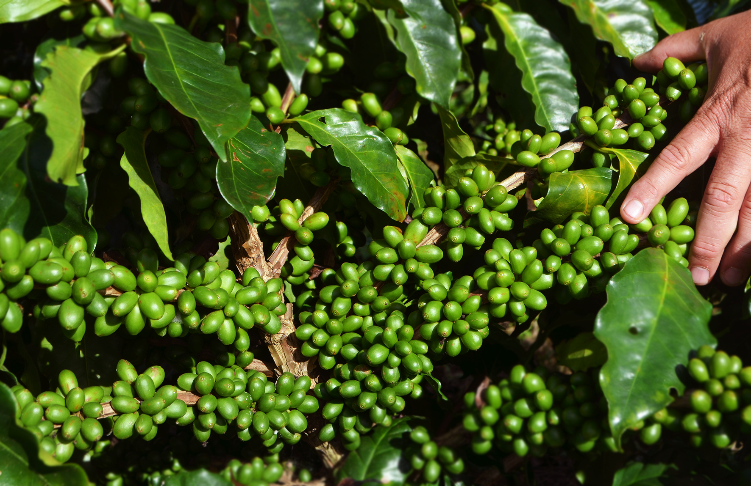

Slide 2
Vista Florencia has been producing coffee and other natural products for 4 generations in Santa Elena Barillas, Guatemala.
Our cup profile is very balanced with intense aromas.
All our coffee is dried in the sun using different methods. We use traditional patios, African drying and a Colombian greenhouse method that we implement as testing in the 2020 harvest.
All our products are produced under adequate quality standards, we put a lot of effort from the selection of seeds, care, and sowing, to later generate a good harvest.

Slide 3
We have a great diversity of products, which together show the exceptional quality of a Coffee Farm that manages to link processes to take advantage of the nutrients of all the threads. We seek a Circular Economy model.
At Vista Florencia we celebrate nature, water, soil, sun, and air. We are a unique place in Central America to demonstrate that agricultural production can also have educational processes and social processes simultaneously.

Slide 4
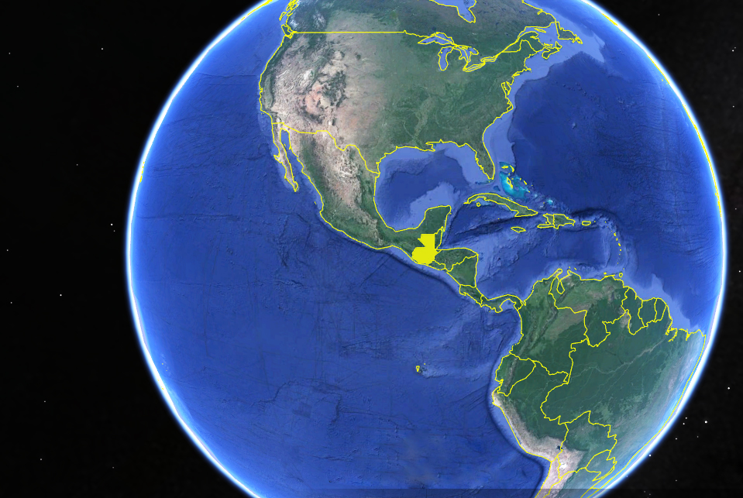
Guatemala

Slide 5
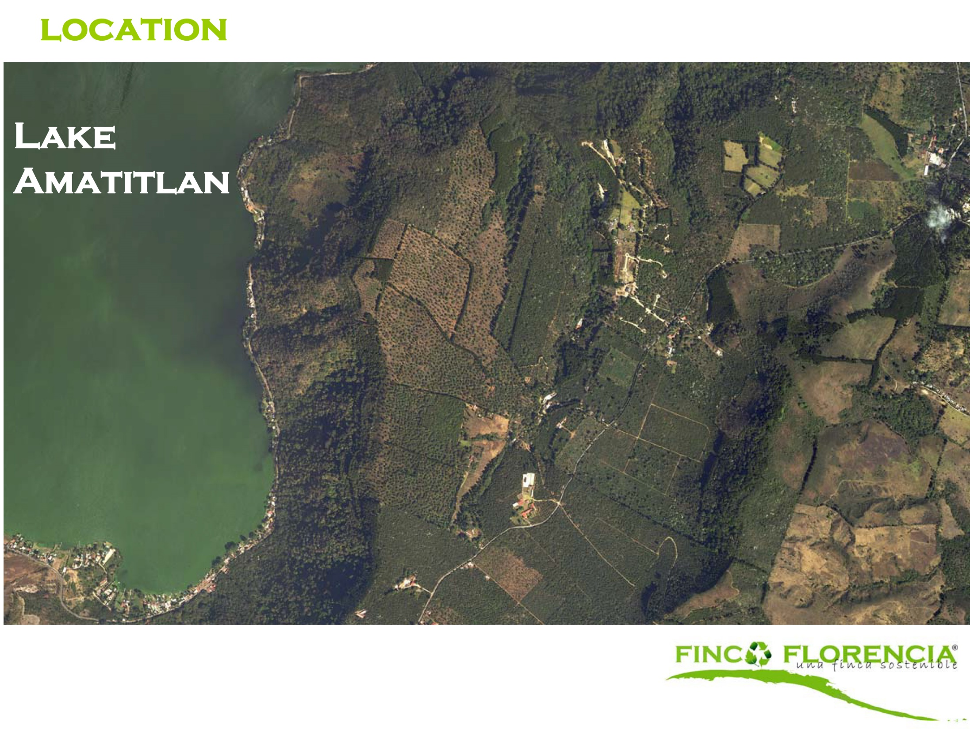
Location
Guatemala

Slide 6
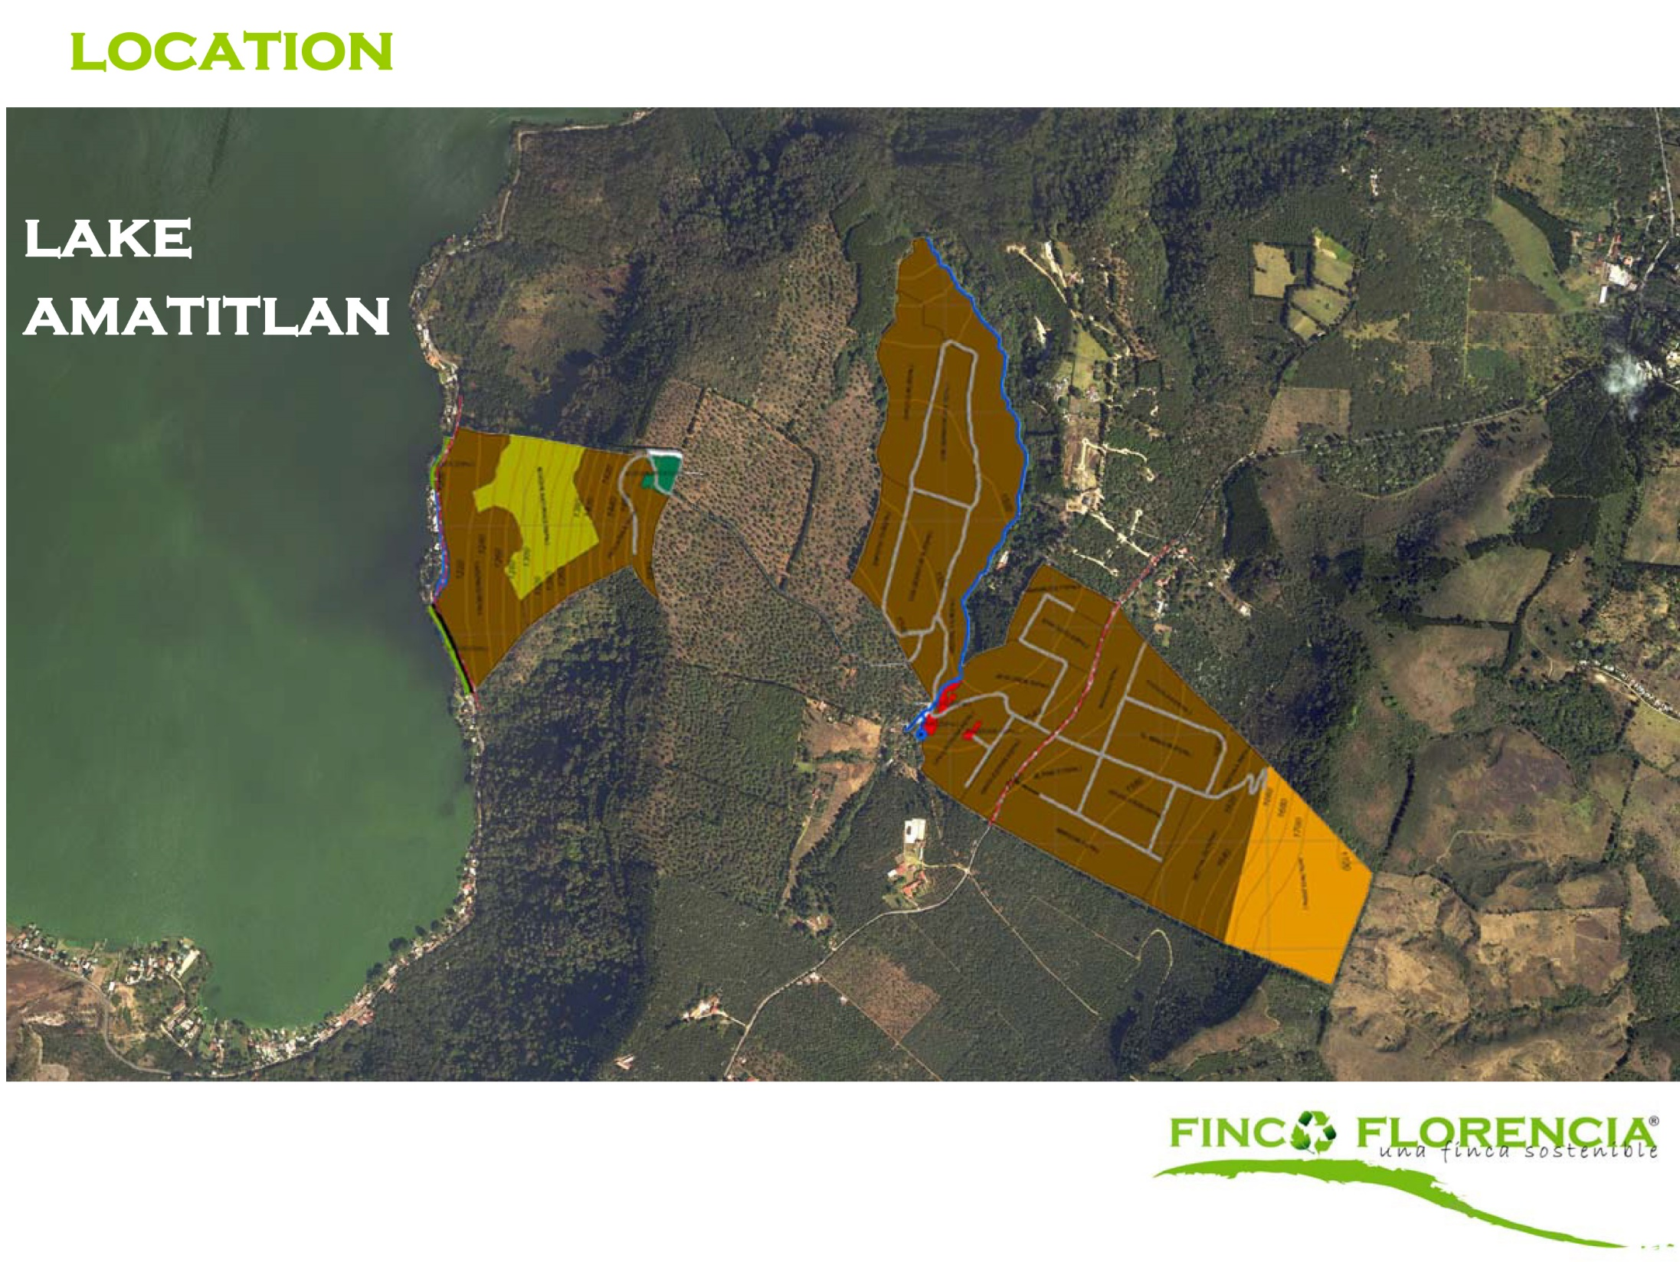
Location
Guatemala

Slide 7
Location

Slide 8
Biodiversity

Slide 9
Biodiversity

Slide 10
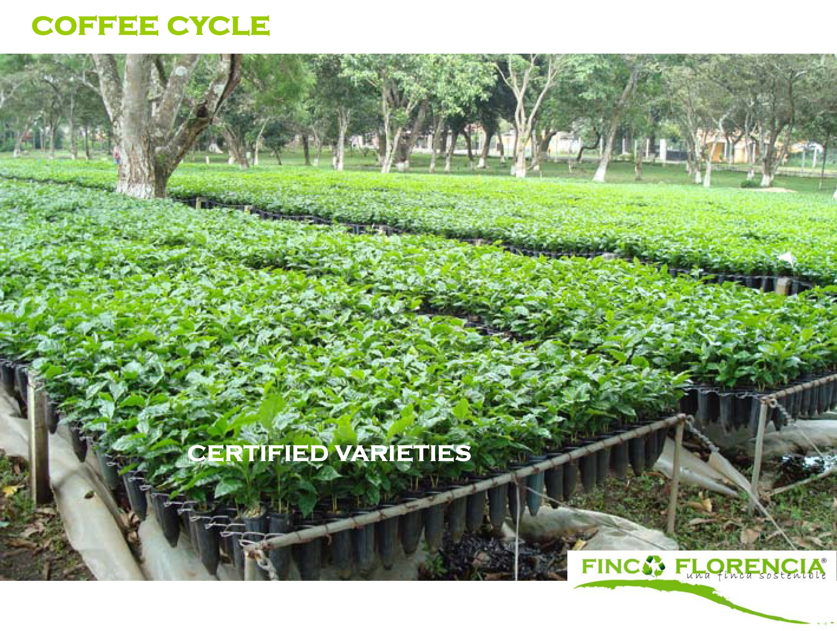
Coffee Cycle

Slide 11
Coffee Cycle

Slide 12
Coffee Cycle

Slide 13
Coffee Cycle

Slide 14
Coffee Cycle

Slide 15
Coffee Cycle

Slide 16
Coffee Cycle

Slide 17
Wet Mill

Slide 18
Wet Mill

Slide 19
Wet Mill

Slide 20
Wet Mill

Slide 21
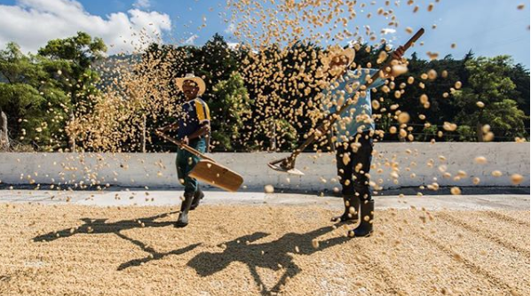
Sun Drying

Slide 22
Sun Drying

Slide 23
Sun Drying

Slide 24
By Products

Slide 25
By Products

Slide 26
By Products
Organic Honey

Slide 27
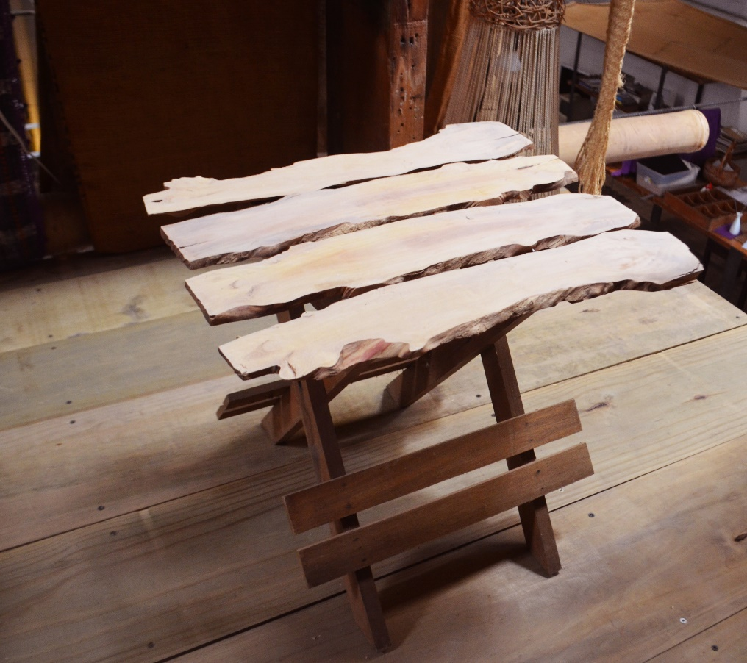
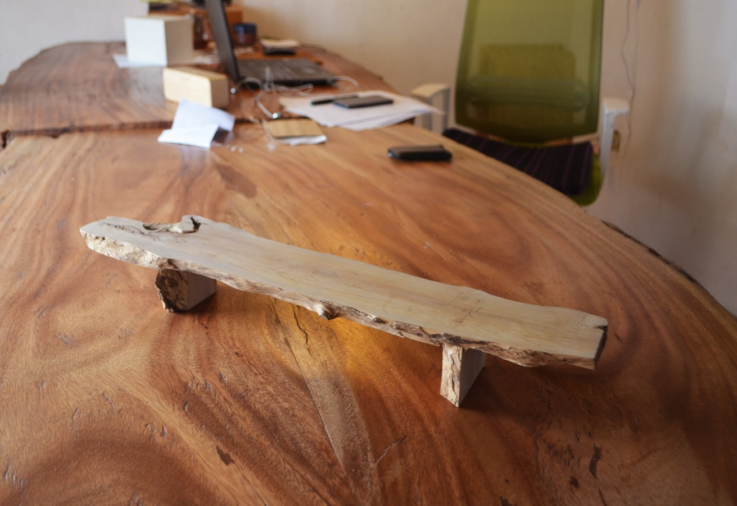
By Products
Coffee Wood Design

Slide 28
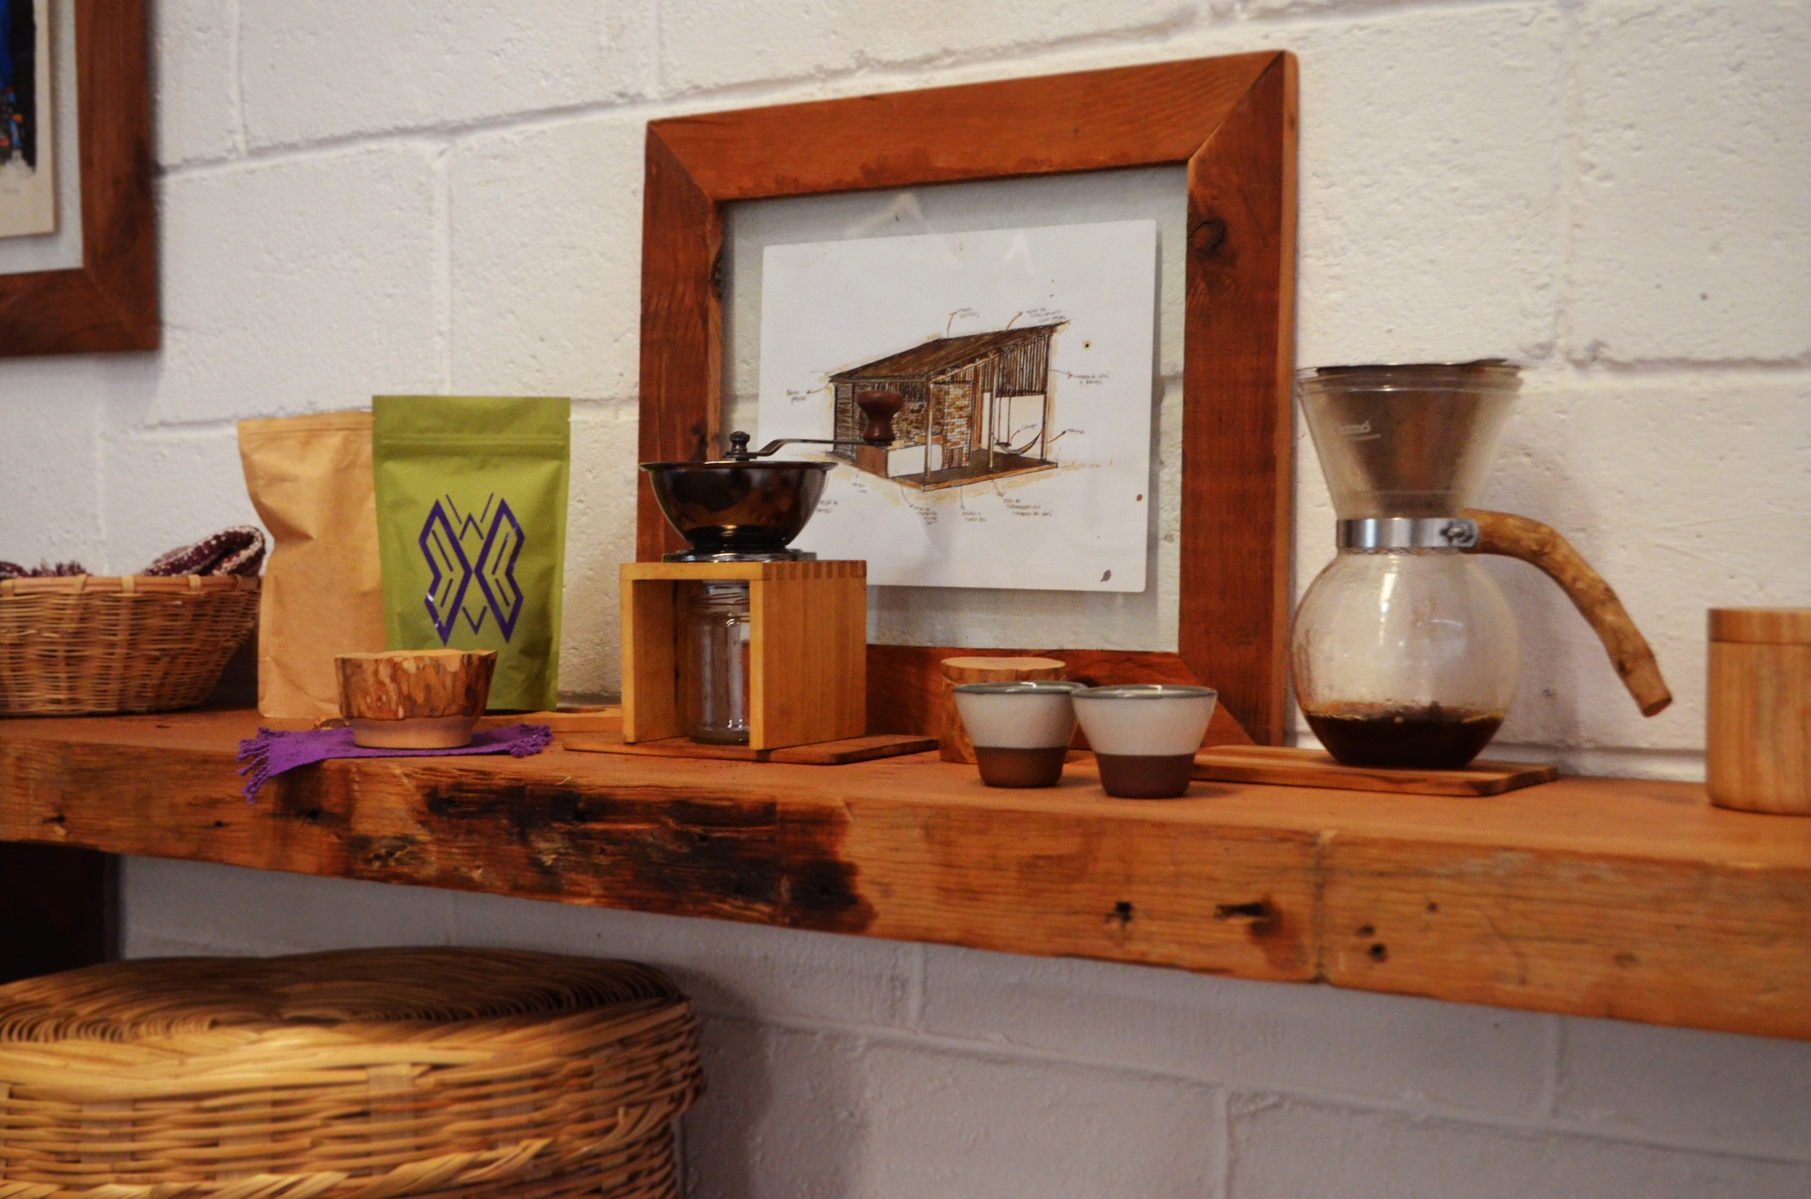
By Products
Coffee Wood Design

Slide 29
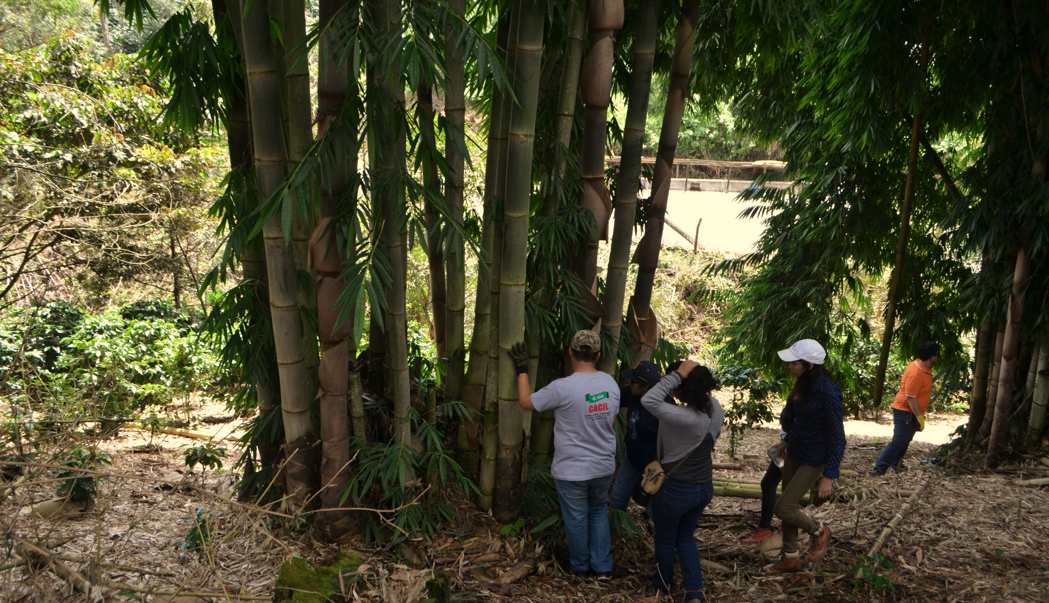
Bamboo Plantation

Slide 30
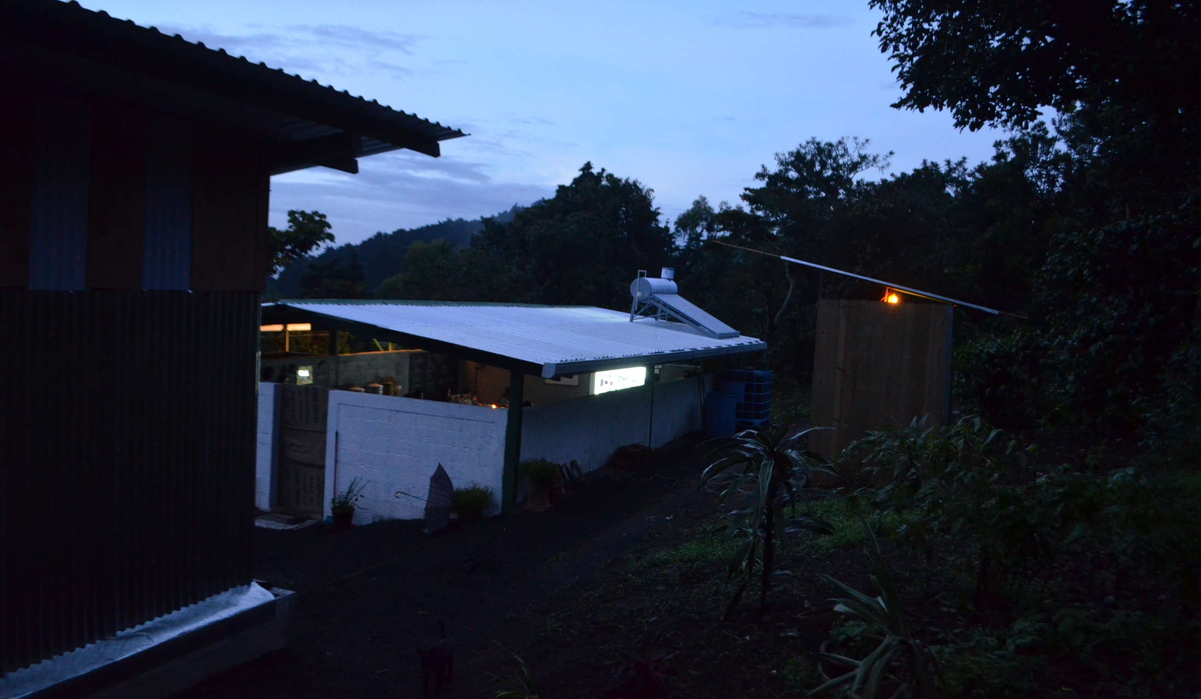
Workers Infrastructure

Slide 31
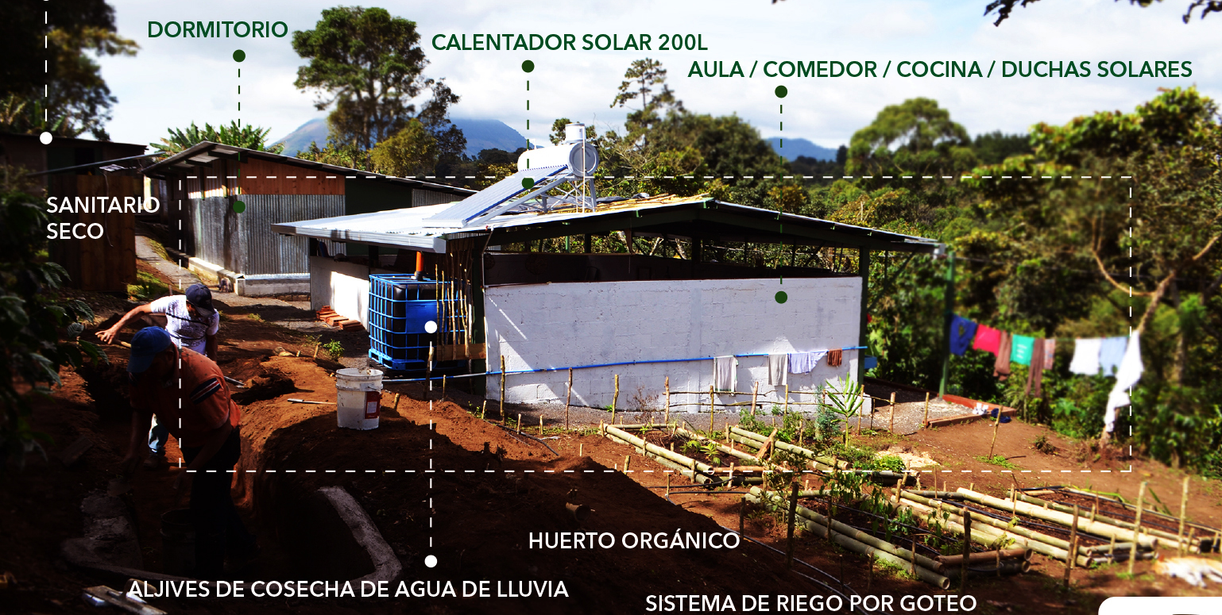
Workers Infrastructure

Slide 32
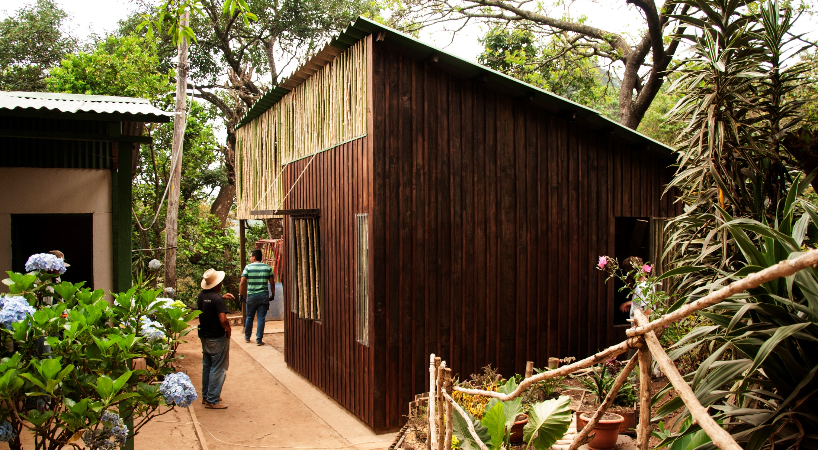
Workers Infrastructure

Slide 33
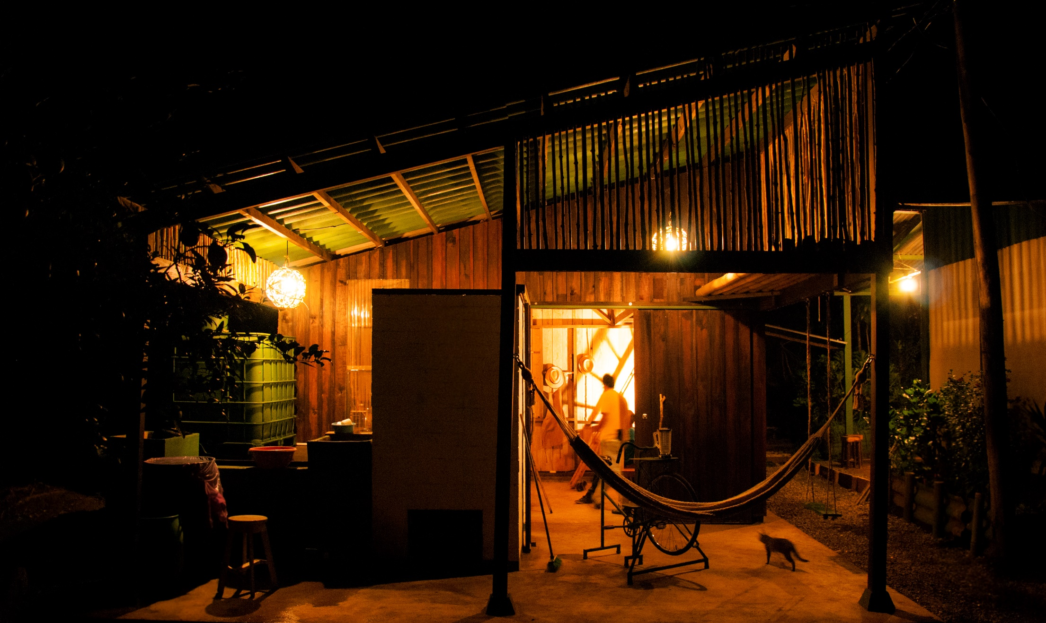
Workers Infrastructure

Slide 34
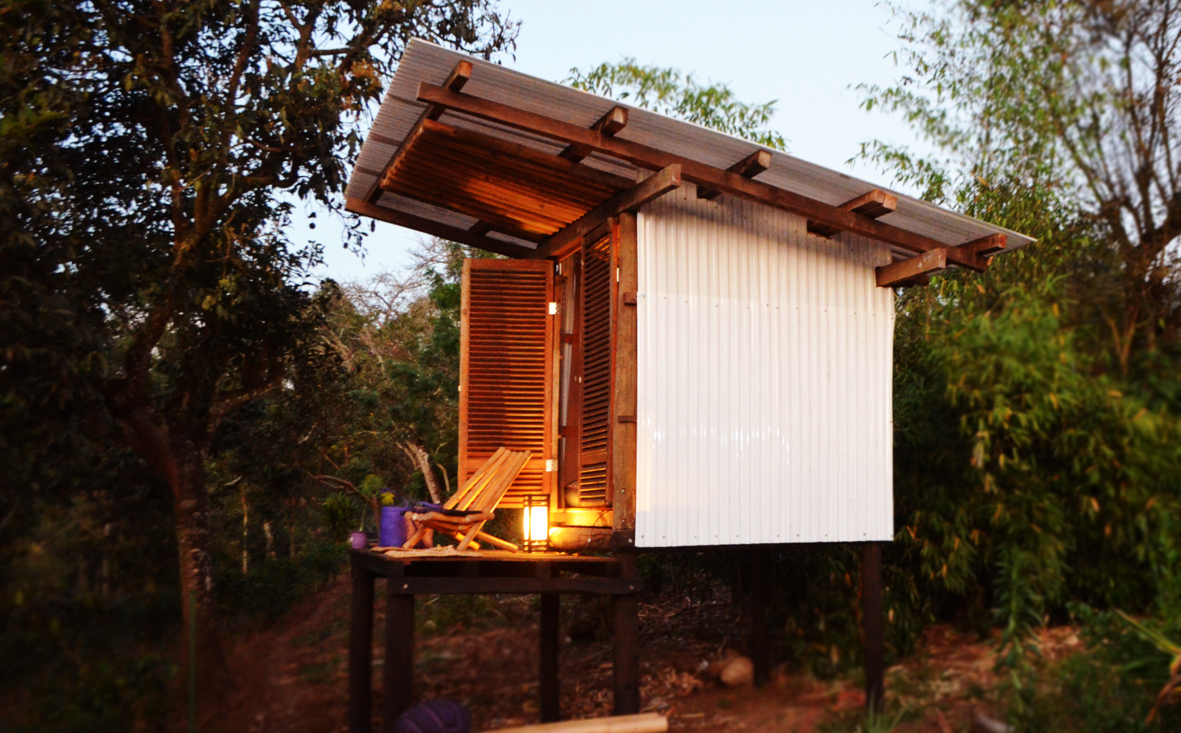
Glamping Shed

Slide 35
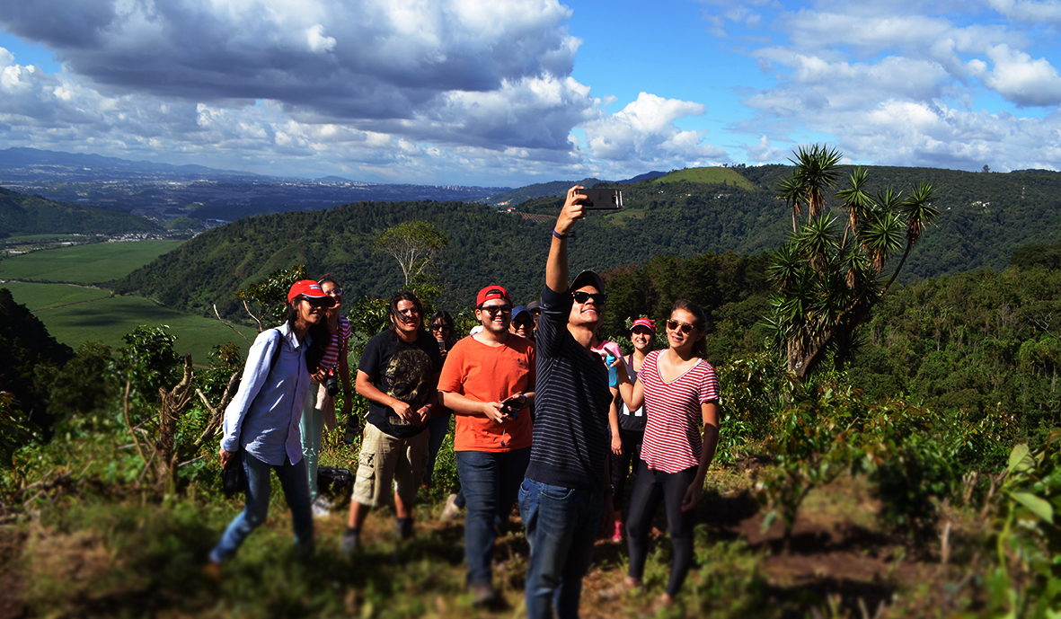
Hiking

Slide 36
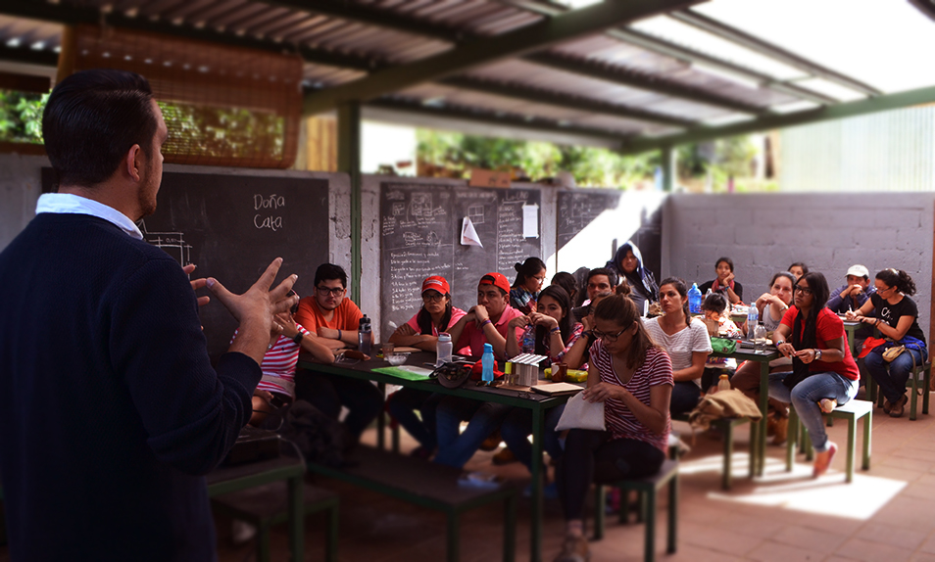
Environmental Education

Slide 37
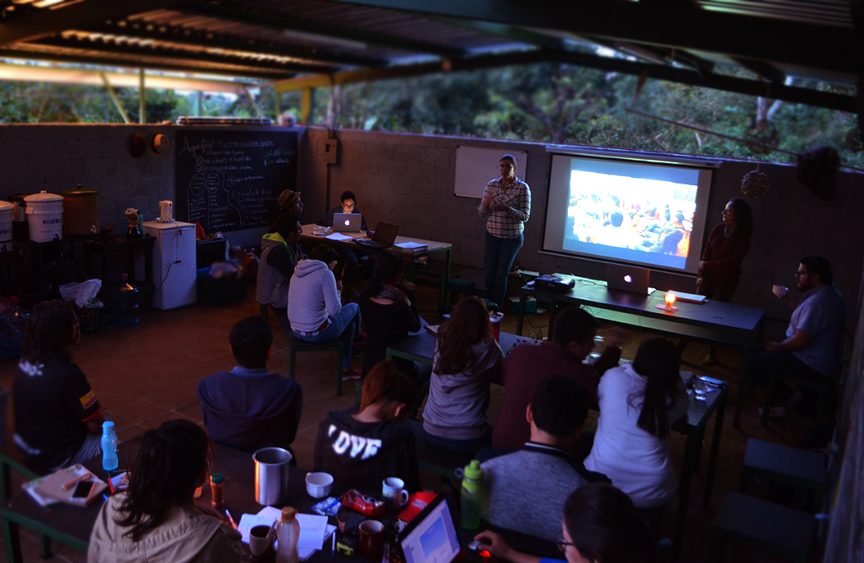
Environmental Education

Slide 38
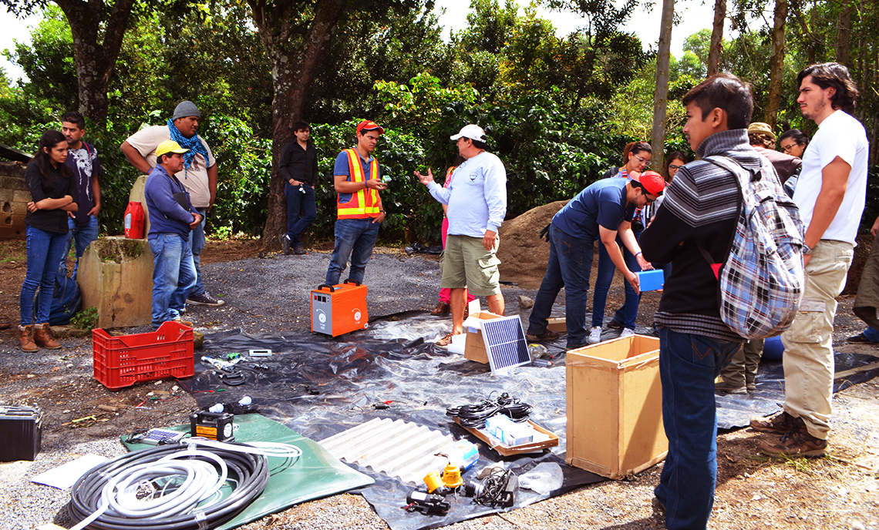
Environmental Education

Slide 39
Coffee Roasting

Slide 40
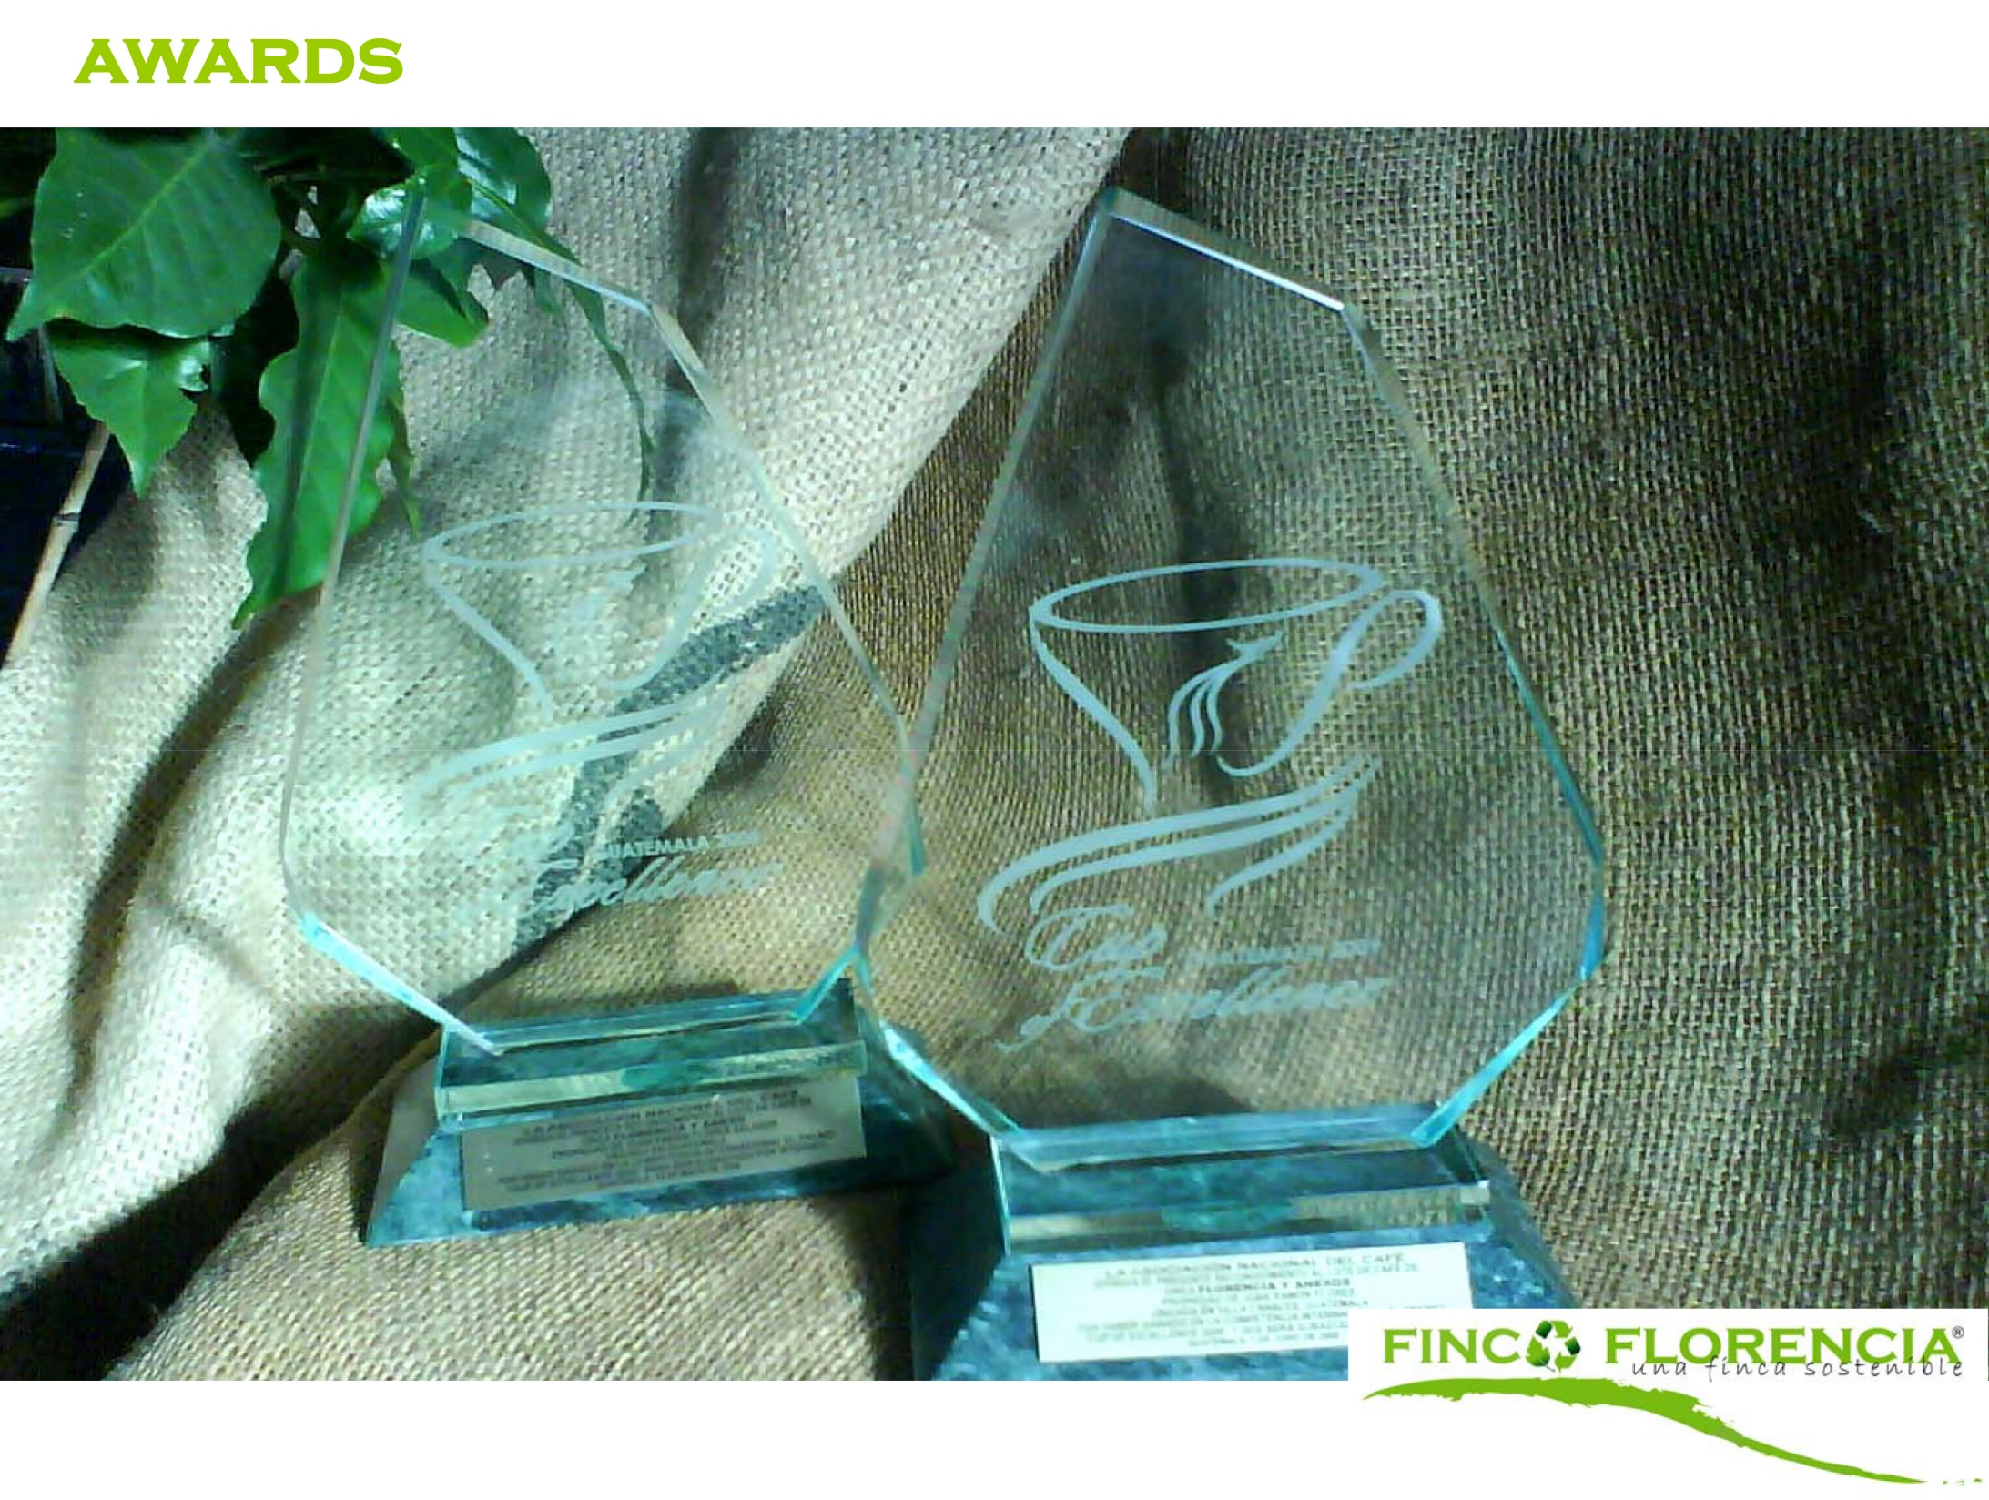
Awards
2 Cup of Excellence recognitions

Slide 41
Awards
Guatemalan Architectural Bienal Award for Best Social Project

Slide 42
Contact
Gerardo Flores
WhatsApp: (502) 5306.6352
gerardofloresc@gmail.com
www.vista-florencia.com
Guatemala, Central America

